Slide 1

Insight
Step 1
Human-Computer Interaction
Master’s Degree in Artificial Intelligence
Spring Semester
2022-23

Slide 2
Introduction
Target population
Individuals who are experiencing mental health challenges, such as anxiety, depression, stress, or other mental health disorders.
Users of all ages, genders, and backgrounds, who may be seeking a safe and supportive space to connect with others and learn more about managing their mental health.
Aims and objectives
Provide a platform for individuals to connect with others who may be experiencing similar mental health challenges.
Encourage individuals to engage in self-care activities such as journaling, mood tracking, sketching, and a daily task or activity to complete that promotes positive mental health habits and routine.
Offer a chatbot that provides a non-judgmental and supportive space for users to discuss their mental health concerns and receive immediate guidance and resources.

Slide 3
State of the art - the techniques
Integration with wearables and IoT devices: They provide real-time tracking and monitoring of mental health metrics such as heart rate variability, sleep patterns, and physical activity levels.
Personalization: The use of artificial intelligence and machine learning offer personalized recommendations and treatments based on user data, symptoms, and preferences.
Teletherapy: It allows users to consult with licensed therapists and receive virtual therapy sessions.
Gamification: Some mental health apps are incorporating gamification elements, such as rewards and challenges, to motivate users to engage with the app and maintain healthy behaviors.
Integration with electronic health records: Some mental health apps are integrating with electronic health records (EHRs) to provide seamless communication between patients, providers, and healthcare systems.

Slide 4



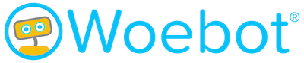
State of the art - the apps
Existing apps/websites with similar functionalities:
Headspace: a meditation and mindfulness app that provides guided meditation exercises and resources for stress and anxiety management.
Moodfit: a mood tracking app that allows users to monitor their emotional state, set goals, and track their progress over time.
Talkspace: an online therapy platform that offers virtual therapy sessions with licensed therapists, as well as a variety of self-care resources and tools.
Woebot: a chatbot app that offers cognitive-behavioral therapy exercises and resources for managing anxiety and depression.

Slide 5

Functionalities and modules
The app will consist of 3 different units:
A. Online support groups
B. Self-care
C. Chatbot

Slide 6
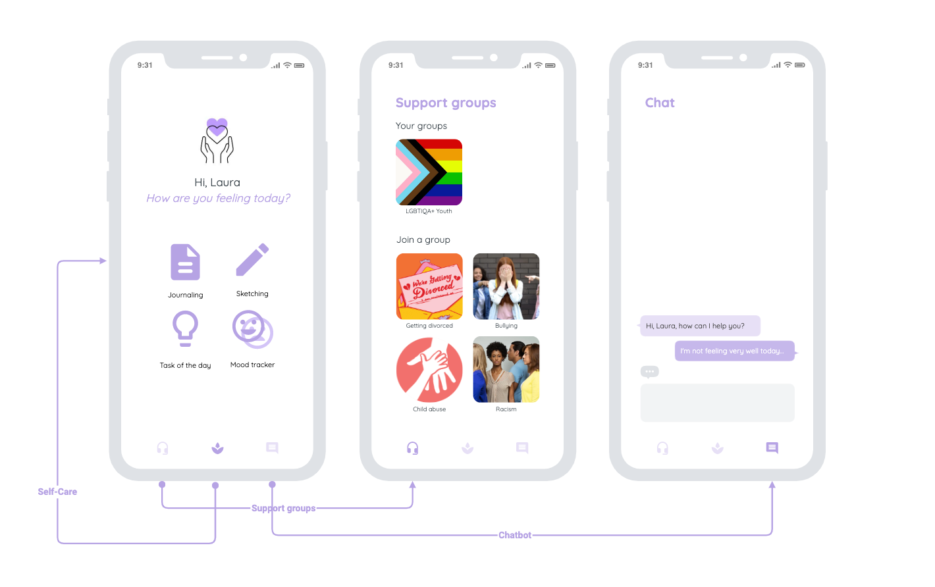

Slide 7
Online support groups
Group selection: users would be able to browse and join different support groups based on their specific mental health concerns or interests
Moderation: the support group may be moderated by a mental health professional or trained peer support leader to ensure a safe and supportive environment for all members.
Video-call, call & chat support.
Guidelines and rules: the support group may have established guidelines or rules for participation, such as no hate speech, respect for others' opinions, and a focus on support and encouragement.

Slide 8
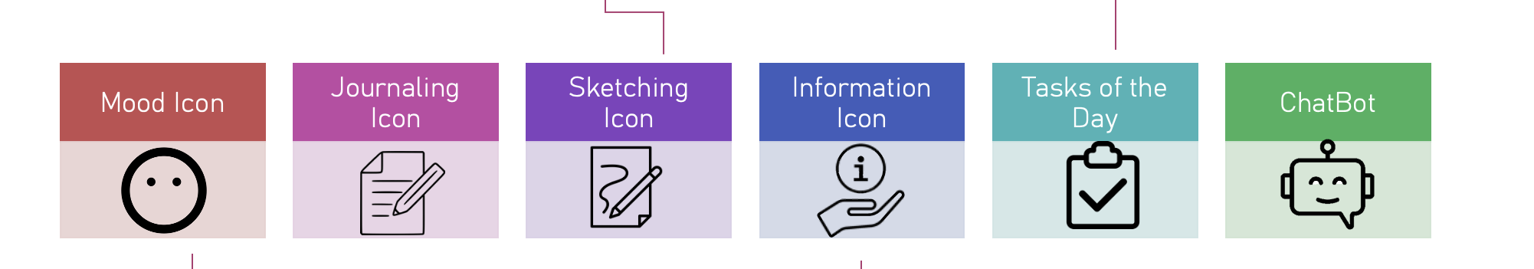
Self-care unit
It will be a safe-space for people who do not want to engage in human-interaction or simply for whomever wants to track their mental journey on their own.
What’s new?

Slide 9
Self-care unit
It will be a safe-space for people who do not want to engage in human-interaction or simply for whomever wants to track their mental journey on their own.
What’s new?

Slide 10
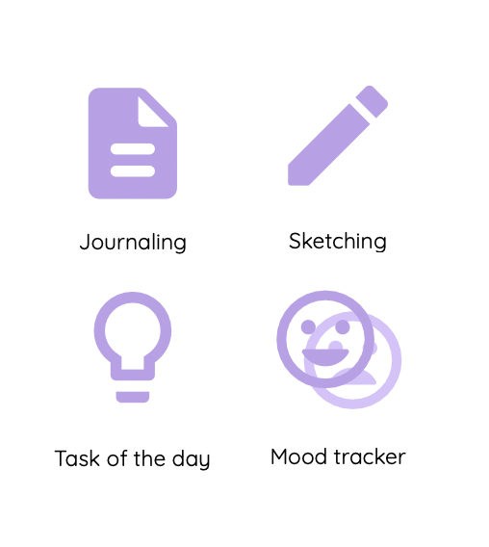
Self-care unit
It will be a safe-space for people who do not want to engage in human-interaction or simply for whomever wants to track their mental journey on their own.
What’s new?

Slide 11
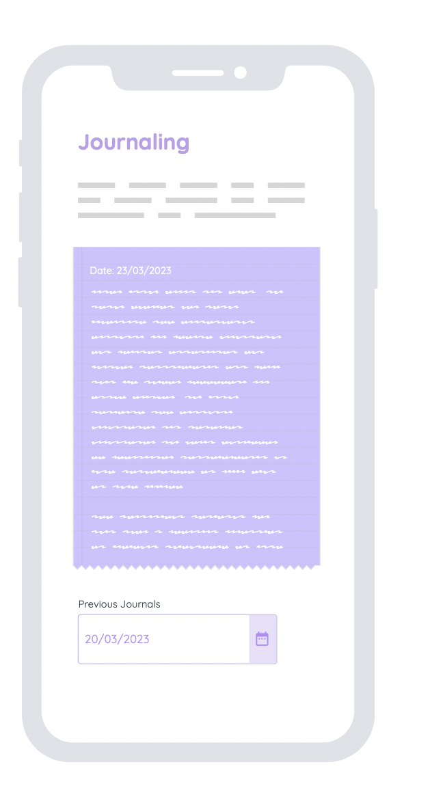
Self-care unit
It will be a safe-space for people who do not want to engage in human-interaction or simply for whomever wants to track their mental journey on their own.
What’s new?

Slide 12
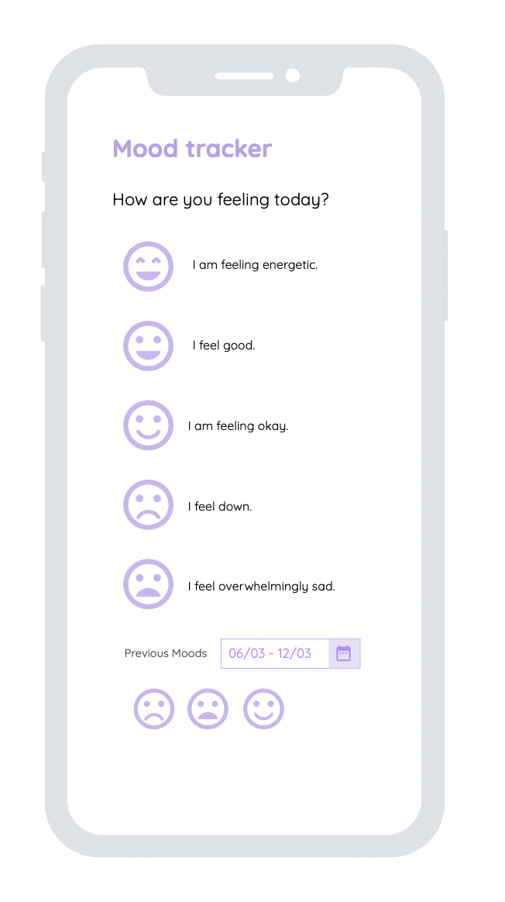
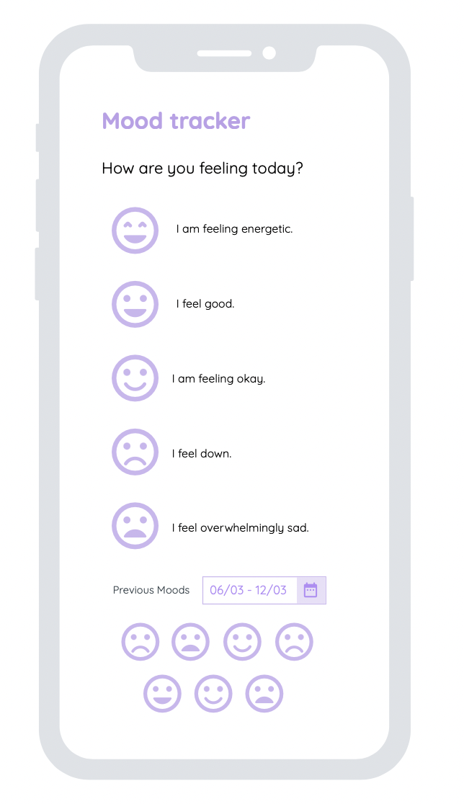
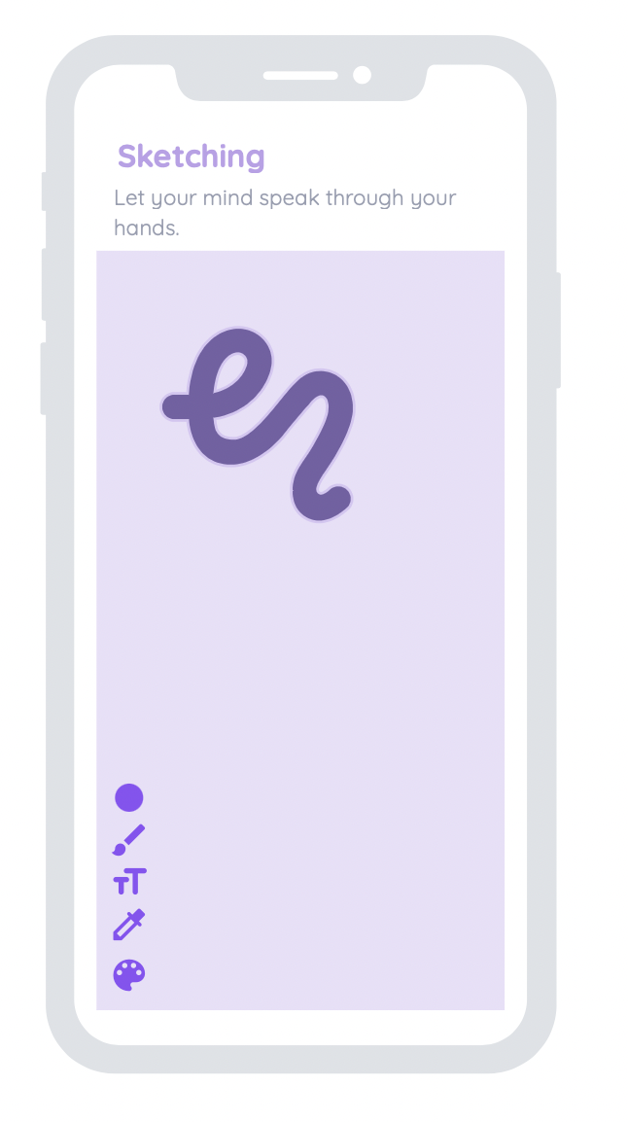
Self-care unit
It will be a safe-space for people who do not want to engage in human-interaction or simply for whomever wants to track their mental journey on their own.
What’s new?

Slide 13
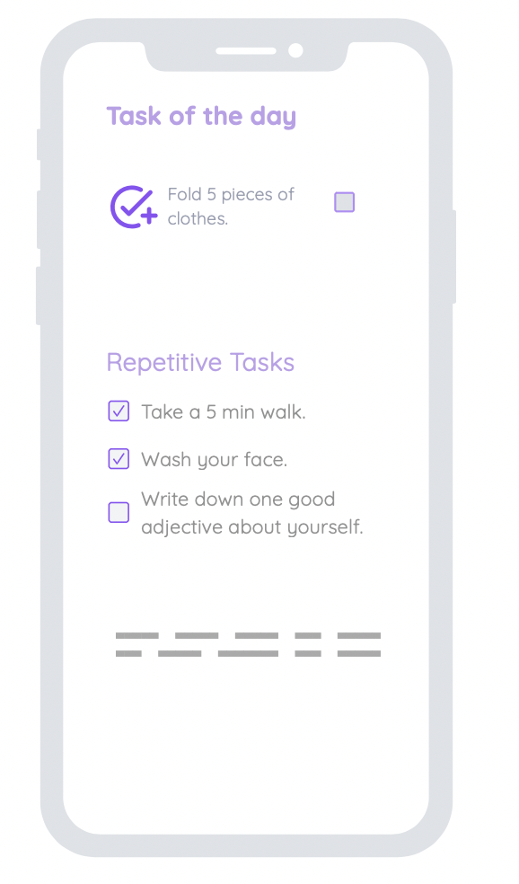
Self-care unit
It will be a safe-space for people who do not want to engage in human-interaction or simply for whomever wants to track their mental journey on their own.
What’s new?

Slide 14
Self-care unit
It will be a safe-space for people who do not want to engage in human-interaction or simply for whomever wants to track their mental journey on their own.
What’s new?

Slide 15
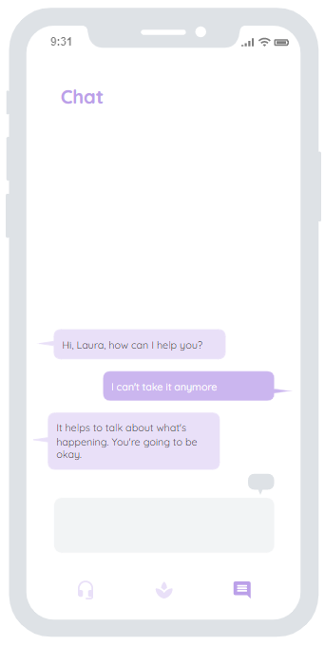
Chatbot
It’s a safe space for whoever has any questions regarding the problem one may have, for an opinion regarding an issue, or just for the ones who want to chit-chat a bit, without having the necessity of finding another person to involve in the conversation.
The chatbot will be based on another API such as GPT-3 or Dialogflow. Even though it would be nice to use GPT-3 to exploit this new amazing technology, Dialogflow seems also to be a good, easier alternative to create specialized chatbot.
Also, we are going to use the “Mental Health Conversational Data” that can be found on kaggle in order to define a specialized chatbot, which will be able to handle people with mental issues properly.

Slide 16
Insight Planning
Ideation and Brainstorming
Contextualization and Planning tasks
Technical production of Insight
Testing and Correcting
March
March - April
April - May
May - June
23 March - Step 1
4 May - Step 2
1 June - Step 3
Ideation, Brainstorming, Context and Tasks Planning
Online Support Groups
Insight Team
Self-care
Chatbot

